Slide 1

China loan analysis prepared by: Kaleab Wondemu

Slide 2
Objective of this work
To analyze the reason why organizations, borrow from China.
To look year over year change of the loan rate in each country.
To forecast the future 10 years loan condition.
To analyze which organizations are more interested to borrow.

Slide 3
Loan analysis
Loan analysis is an evaluation method that determines if loans are made on feasible terms and the reason that loan is made, who lends, and from which sector.
China is one of the lender countries that lend to other countries.
The dataset has 9 columns namely: Expand All | Collapse All, YEAR, AMOUNT, LENDER, BORROWER, SECTOR, SENSITIVE TERRITORY OVERLAP, and Country.

Slide 4
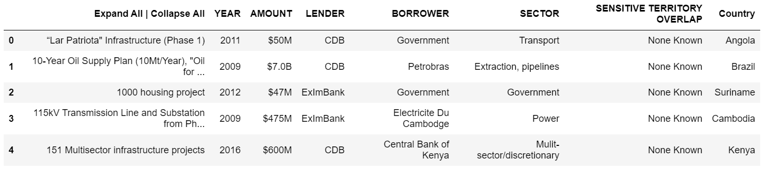
Cont…

Slide 5
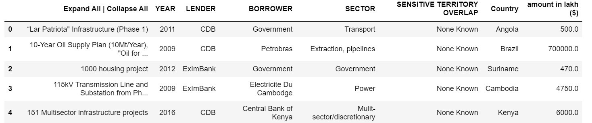
Cont.… After some transformation is done.

Slide 6
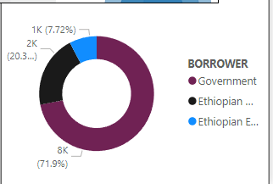
Borrowers
Organizations that are borrowed from China. (e.g., Government, banks, construction companies,…)

Slide 7
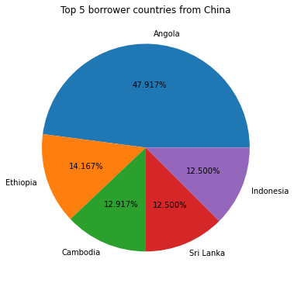
Countries
Country in this context, the name of the country in the borrowed organizations exists.
The top 5 countries are:
Angola
Ethiopia
Cambodia
Sri Lanka
Indonesia

Slide 8
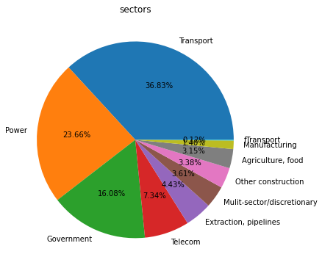
Reasons (sectors)
Sectors are reasons why borrowers lent.
There are different reasons (Sectors) why countries are borrowed.
Some of the reasons are:
Transport
Power
Government
Telecom
And others

Slide 9
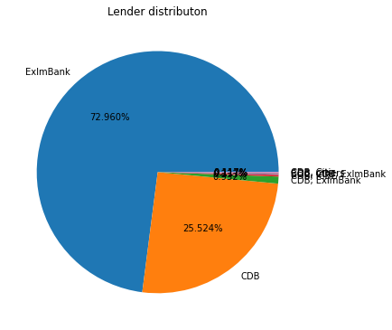
Lenders
Lender is an organization or person that lends money.
There are many lenders on this dataset.
Some of the lenders are:
ExlmBank
CDB
CDB,ExlmBank
And others

Slide 10
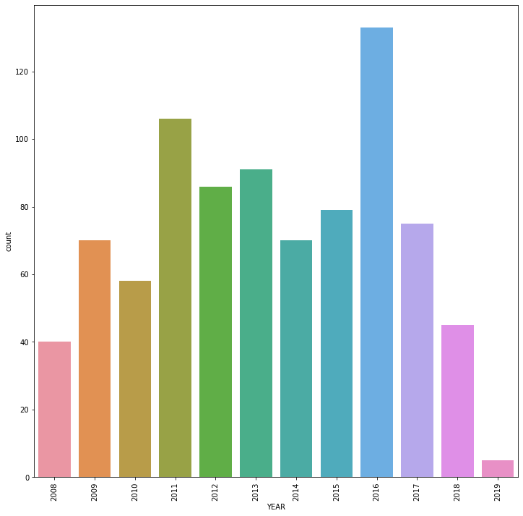
Years
This dataset is a year from 2008 to 2019.

Slide 11
Attention
The above graphs are for visuals, they don’t have that much insight.
They are just for understanding the business problem.
Please see the power bi dashboard to get some insight.

Slide 12
Thanks!

